Slide 1
GenoCAD/SBOL Visual Implementation
Mandy Wilson
Virginia Bioinformatics Institute (VBI)
January 5, 2012

Slide 2
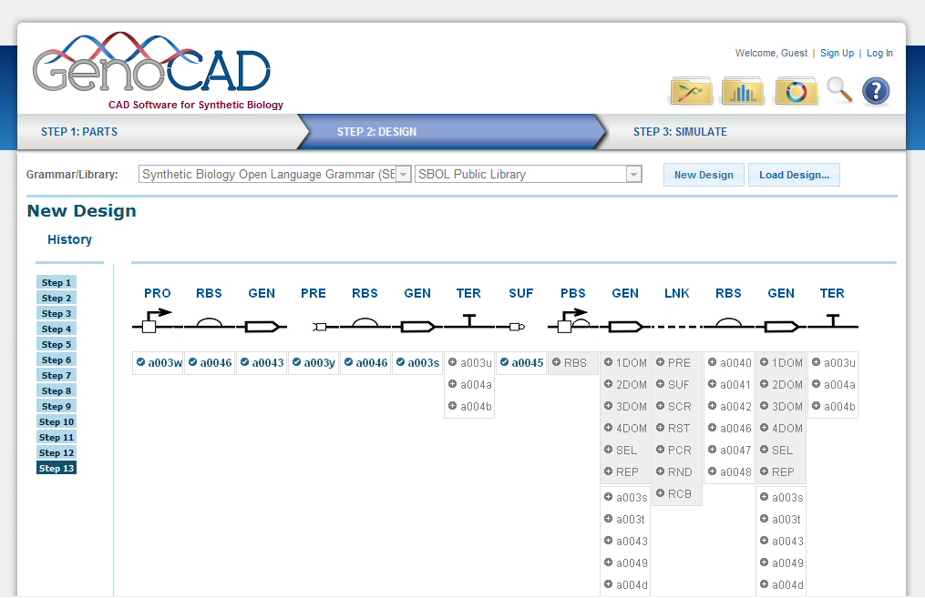
This is now …
GenoCAD has been SBOL-Visual compliant for over a year now.

Slide 3
… but Coming Soon
GenoCAD v.2.1 offers Grammar Editor support
Copy existing grammars
Create grammars from scratch
Export and Import grammars
Add/modify/remove rules
… But what does this have to do with SBOL Visual? Easy upgrades!

Slide 4
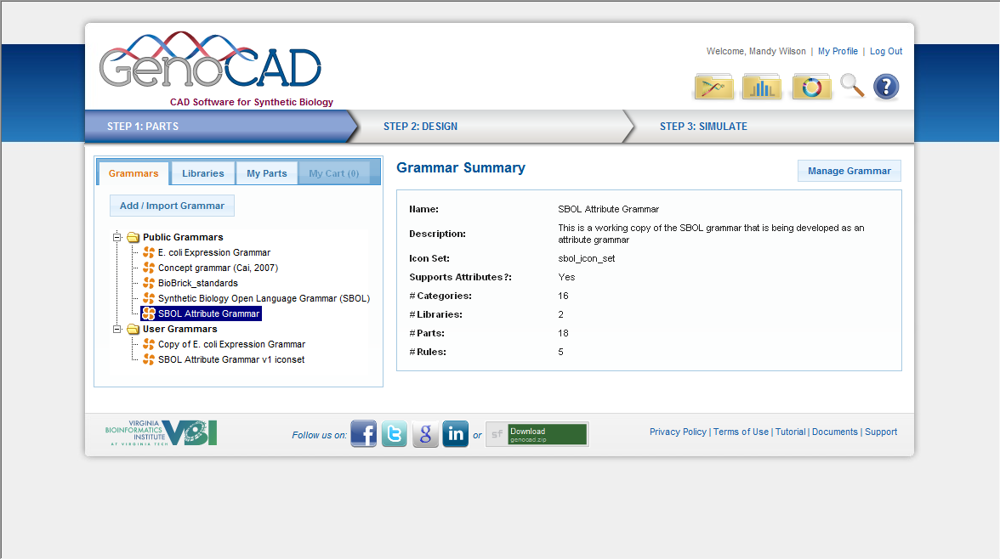
Select a Grammar

Slide 5
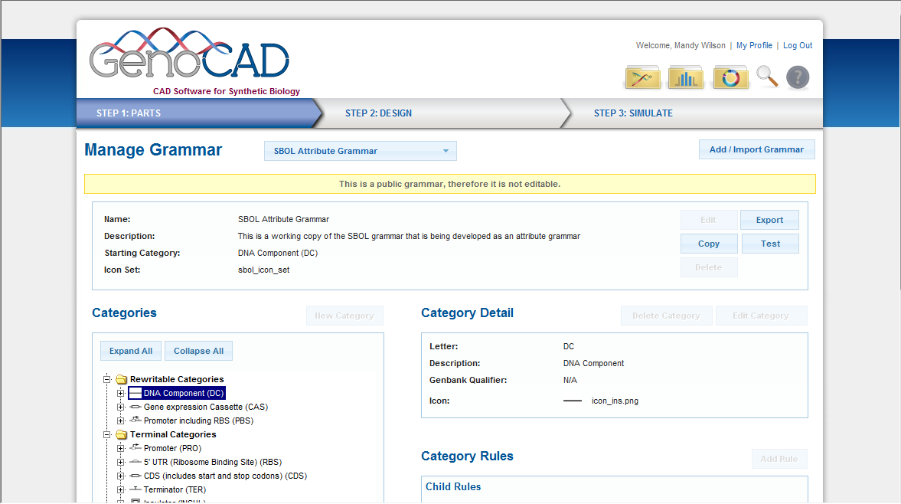
Copy Existing Grammar

Slide 6
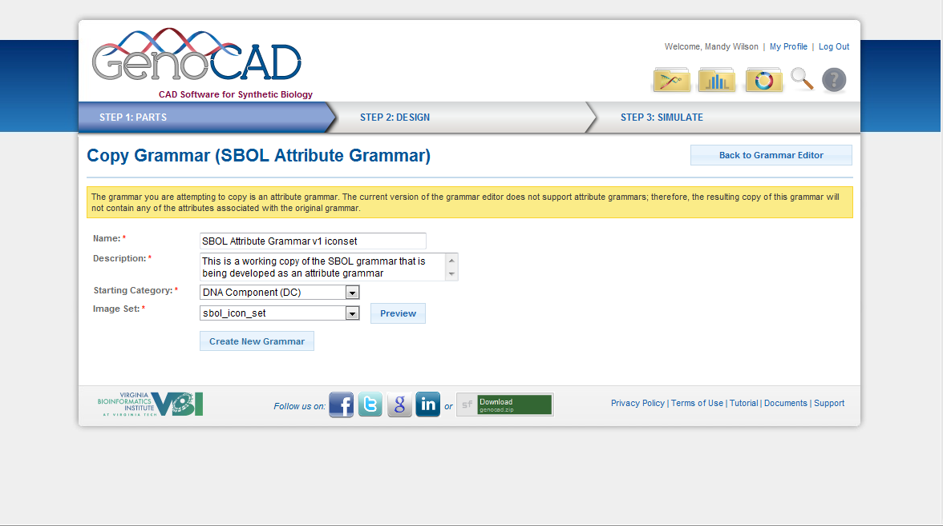
Change Default Settings As Needed

Slide 7
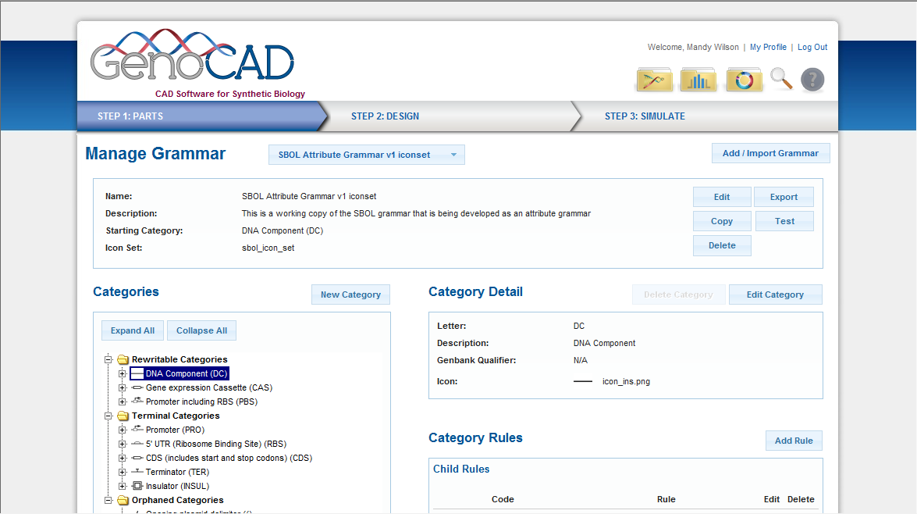
New Grammar
With Your Own Grammar:
Add/Edit/Remove Categories
Create and Modify Rules
Test your grammar, make sure rules work properly
Change the iconset representing the grammar in other parts of the application

Slide 8
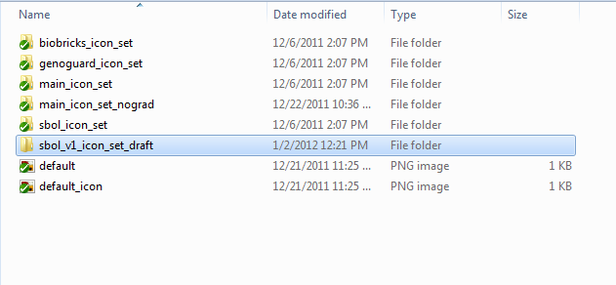
New Version of SBOLv Iconset?
No problem!
Behind the scenes we:
Download latest version of the SBOLv icons
Save into 16x16 and 48x48 pixel images (PNG)
Modify as needed
Save under the images/grammars directory as a new iconset

Slide 9
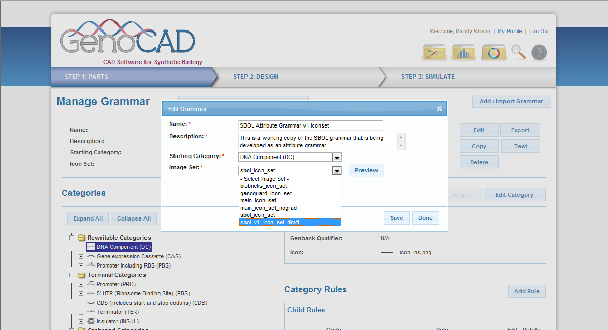
Edit Grammar to Update

Slide 10
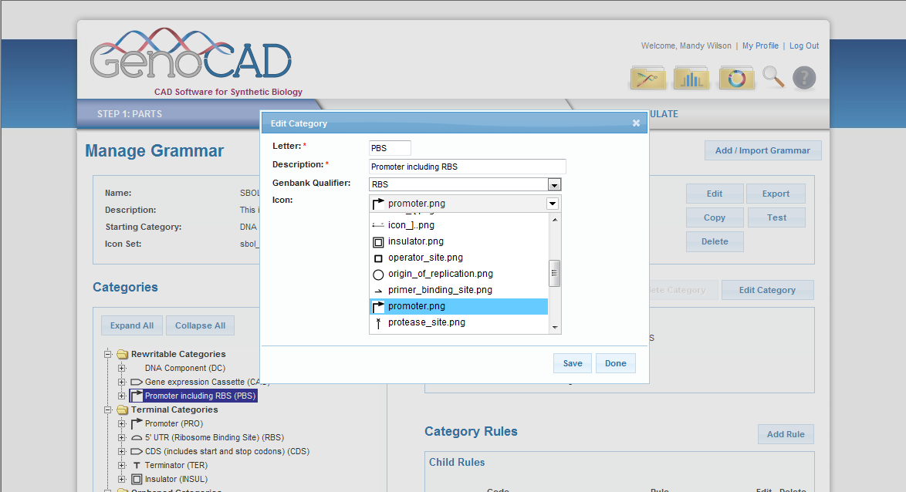
Edit Categories to Fix Icons if Needed

Slide 11
Summary
GenoCAD Grammar Editor will improve SBOLv support
Beyond SBOLv, in GenoCAD v.2.1:
Anyone can make rules, create grammars
Grammars will be easy to develop, support
Easier to test grammars
Is it time to consider the development of an official SBOL Grammar?

